Slide 1
CHAMPIONNAT DU MONDE DE HOCKEY SUR GLACE 2017 DE L‘IIHF
TEAM MEDICAL HANDBOOK

Slide 2
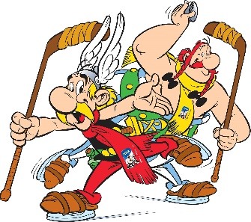
TABLE OF CONTENTS
WELCOME LETTER
MEDICAL ORGANIZING STRUCTURE
TEAM MEDICAL PERSONNEL MEETING AGENDA
MEDICAL POLICIES AND PROCEDURES
EMERGENCY ACTION PLAN (EAP)
DOPING CONTROL
APPENDIX

Slide 3
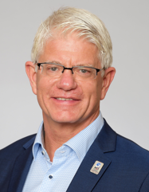
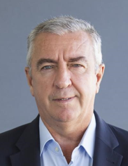
I. WELCOME LETTER
Dear Ice Hockey Friends,
We would like to warmly welcome you to the cities of Cologne and Paris, the host cites of the 2017 IIHF Ice Hockey World Championship !
We are very pleased to finally have you around after a long road that started back in May 2013, when the IIHF Annual Congress voted for the very first time in favor of a joint bid of two nations, Germany and France.
Under the motto “Together for 2017” we gathered a crew of motivated hockey lovers that soon became a team with multinational spirit, ideas and dreams. Now all members of our Organizing Committee are taking great pride in presenting ourselves to you as two different nations, but one common host.
Together with you, your teams, the fans, Asterix and Obelix, we are looking forward to experiencing a unique event, great sport, big emotions and lots of fun during the 2017 IIHF Ice Hockey World Championship in Germany and France.
Let’s all celebrate :
Together for 2017 !
Ensemble Pour 2017 !
Gemeinsam für 2017 !
Franz Reindl
Luc Tardif

Slide 4
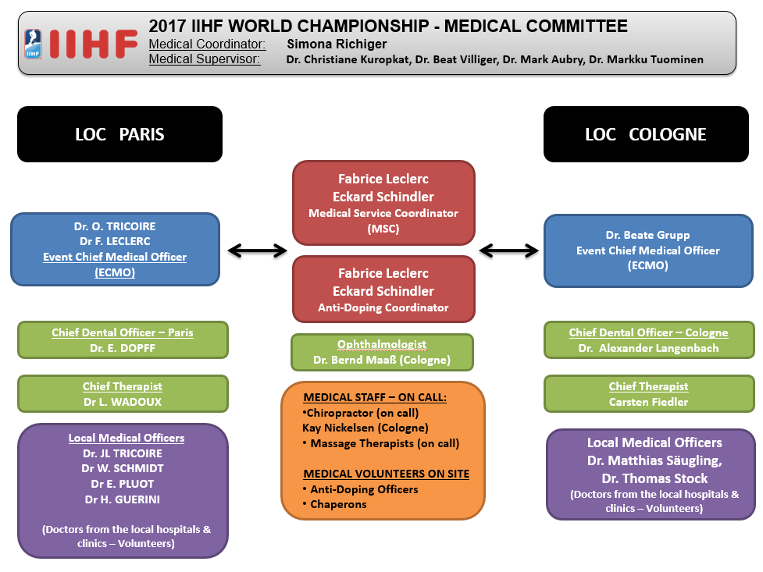
II. MEDICAL ORGANIZING STRUCTURE

Slide 5
III. TEAM MEDICAL PERSONNEL MEETING AGENDA
THURSDAY, MAY 4TH – 16:00
Louis Magnus Lounge / ACCORHOTELS ARENA (AHA)
  Welcome
  Host organizing commitee medical program services
  Host organizing commitee services
  IIHF Injury Reporting System
  Doping Control Program
  Medical Policies
    - IIHF concussion Protocol
    - Injured Athlete, EAP, Removal from ice procedures
    - Blood Spill procedures
  Others

Slide 6
IV. MEDICAL POLICIES AND PROCEDURES
1. ROLE OF HOST PHYSICIANS
The primary role of the volunteer physicians is to act as an EVENT PHYSICIAN, which includes:
Liaise with, and provide support for, the national team physicians in order to ensure the provision of comprehensive local medical care during the event.
b) Provide urgent or emergency medical care assistance if necessary.
→ Return to play and fitness to play decisions are the responsibility of the national team physician.

Slide 7
IV. MEDICAL POLICIES AND PROCEDURES
2. MEDICAL PERSONNEL ON SITE
All physicians, surgeons, dentists and therapist providing game coverage are licensed to practice in France and are registered as accredited volunteers with the organizing committee.
Medical staff will have proper accreditation and outfitting that identifies them accordingly.
The primary role of the host medical staff is – as with the physicians – to work with and support the national team medical staff in accessing or delivering care for the athletes.
Dr Fabrice Leclerc MD (ECMO From May 4th to 10th)
Dr Olivier Tricoire MD (ECMO From May 11th to 18th)
Dr Eric Dopff (Chief Dental Officer)
Eric Wadoux (Chief Therapist)

Slide 8
IV. MEDICAL POLICIES AND PROCEDURES
3. AMBULANCE
A dedicated ambulance with trained paramedics will be on site at the AccorHotels Arena (AHA) for all games, and only on call for practices as it is very close (10 minutes max.)
Paramedics should check with the duty physician prior and the intensive care physician (for the games) to leaving.
In most cases the event ambulance will NOT be asked to transport a seriously ill or injured athlete.
The event staff will stabilize the athlete and Venue PCO will manage transfer to the Centre Hospitalier Universitaire (CHU) thru emergency system (SAMU de Paris)

Slide 9
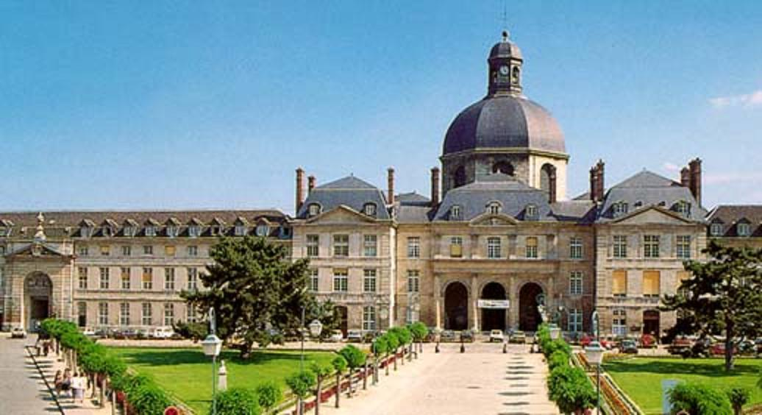
IV. MEDICAL POLICIES AND PROCEDURES
4. HOSPITAL & COSTS
The Championship Hospital is « Hôpitaux Universitaires La Pitie Salpêtrière » - (2kms from the AHA)
Further information on the hospitals is available in Appendix A.
Please be reminded that teams should be prepared to pay or being reinvoiced by the IIHF for any hospital costs (admission, diagnostic imaging, other tests, surgery) at the time the patient is treated, and then be reimbursed by their insurance company.

Slide 10
IV. MEDICAL POLICIES AND PROCEDURES
5. MEDICAL CLINIC AND EQUIPMENTS
The medical clinic at the AHA will be open 1 hour prior to and ½ hour following all games and during practices.
The duty physician, host surgeon, dentist, and therapist will be available for advice, support and assistance.
For non-urgent medical advice, support or assistance when the medical clinic is not activated, please call the chief medical officer.
  Dr Fabrice Leclerc : +33 642 31 56 77 from May 4th to 10th
  Dr Olivier Tricoire : +33 623 89 93 59 from May 11th to 18th

Slide 11
IV. MEDICAL POLICIES AND PROCEDURES
6. MEDICAL CLINIC AND EQUIPMENTS
The following medical equipment will be available in the Medical Clinic :
  - X-Ray Equipment Rafale B DR
  - Ultrasound scanner Logiq E9 xd clear
  - Defibrillator Responder AED
  - ECG Mac 2000
The following medical equipment will be available in Zimmer Area :
  - Physio SD Komplet
  - EnPuls Pro
  - Thermo TK

Slide 12
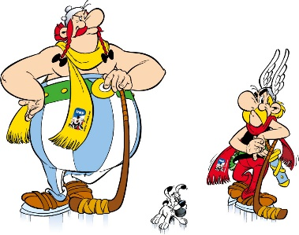
IV. MEDICAL POLICIES AND PROCEDURES
7. IMAGING
At the venue, immediate x-ray and ultrasonography will be available
Any need of more extensive imaging will be referred to our affiliated hospital or an x-ray clinic.
Further details will be provided at the Team Medical Meeting.

Slide 13
IV. MEDICAL POLICIES AND PROCEDURES
8. MASSAGE THERAPY
A program to allow athletes to have access to massage therapy has been set up for the duration of the Championship.
We will have a massage therapist-osteopath available at the venue on a daily basis.
Schedule will be posted in the Medical Clinic.
Priority will be given to athletes requiring massage for injury recovery, as well as to athletes who have pre-booked their appointments.
Please see the Chief Therapist to arrange an appointment.

Slide 14
IV. MEDICAL POLICIES AND PROCEDURES
9. ON-SITE PHARMACY
A limited pharmacy of medications (for emergency use only) will be available at the venue. Written prescriptions may be given for medications required beyond an initial supply after consultation between the team and event physicians.
Contact information for a local 24-hour pharmacies is included in the Appendix of this manual.
Prescription from any medical doctor, belonging to EU, is valid in France
The cost of medication or medical supplies that are not available at the Medical Clinic is the responsibility of each team.

Slide 15
IV. MEDICAL POLICIES AND PROCEDURES
10. DENTAL SERVICES
A host dentist will be available at every game to assist with the management of oral, facial and dental injuries. He will be able to provide the following services on-site that may allow an athlete to return to play :
  repositioning of a dislocated TMJ
  replantation (if indicated) of an avulsed tooth
  repositioning of a luxated tooth
  stabilization of a dislodged or loosened tooth
  treatment of a damaged or exposed nerve
  smoothing of a small fracture of the enamel
However, the decision to return to play will be the responsibility of the team medical staff.
Athletes will be transported to either on-call private dental clinic or hospital if more extensive treatment or radiographs are indicated.

Slide 16
IV. MEDICAL POLICIES AND PROCEDURES
11. PRACTICE SESSIONS
ECMO and physiotherapist will be on site during all practices sessions to manage any injury or illness requiring transport to hospital
In any emergency situation, on-call ambulance will be on site within a 10 minutes maximum delay
AED and emergency supplies will be available in the Medical clinic.

Slide 17
IV. MEDICAL POLICIES AND PROCEDURES
12. SPECTATORS & OFFICIALS
  Separate first aid staff and clinic for spectators are open on site. In the event of any emergency, host medical staff may assist in any manner possible providing that medical care for athletes is not jeopardized.
Host medical staff will also be responsible for medical treatment of on-ice officials, coaches, IIHF staff and other team officials.
Host medical staff are not responsible for medical treatment of media, family members of athletes, or any other visitors other than those described above. These individuals will be directed to the walk-in family practice clinics , or to a hospital emergency department in more urgent situations.

Slide 18
IV. MEDICAL POLICIES AND PROCEDURES
13. BLOOD SPILL MANAGEMENT
  All medical personnel must wear gloves when in contact with or when there is potential to be in contact with body fluids of any kind.
  A bleeding or blood-stained athlete must be removed from the playing area until the wound is properly treated and covered, and any blood cleansed.
  Blood-stained equipment or clothing must be appropriately cleansed or replaced prior to return to play. In certain cases, the athlete may change jerseys if needed. As well, blood soaked ice surfaces must be scraped, and other areas (benches, medical treatment tables, floors) must be cleaned with an appropriate solution.
  The host therapist will be available to assist with following these protocols.

Slide 19
IV. MEDICAL POLICIES AND PROCEDURES
14. CONTROL OF COMMUNICABLE DISEASE
Teams should avoid the sharing of water bottles or towels wherever possible. In the penalty box area, only single use drinks and towels will be provided.
Hand sanitizer will be available throughout the venues and should be used.
Training equipment should be wiped down after use. Single use disposable cups should be used in the dressing rooms. Massage and therapy tables should be properly cleaned after use.
Team medical personnel should attempt to isolate any athlete or staff member who shows signs of a potential communicable disease.
If there is any indication of a potential outbreak of any disease, the CMO should be immediately notified.

Slide 20
IV. MEDICAL POLICIES AND PROCEDURES
15. IIHF CONCUSSION MANAGEMENT PROTOCOL
The IIHF Concussion Management Protocol will be followed by all host staff.
An athlete who shows any signs or symptoms of concussion must be removed from the playing area and reassessed in a quiet area.
Team staff shall follow the IIHF concussion protocol in the event of a concussion. Concussion protocols will be reviewed at the Team Medical Meeting.
The Team Physician shall consult the IIHF Medical Supervisor. In case of disagreement about the return on ice the IIHF Medical Supervisor will inform the Directorate Chairman.

Slide 21
V. EMERGENCY ACTION PLAN (EAP)
1. PRIOR TO THE GAME
Either the duty physician or host therapist will meet with the team physician prior to every match to identify any problems, discuss the following protocol and confirm communication to be used during the game and game injury situations (hand signal etc.)
These protocols will also be reviewed during the Team Medical Personnel Meeting on May 4th

Slide 22
V. EMERGENCY ACTION PLAN (EAP)
2. ON-ICE RESPONSE
In the event of an injury on the ice during a game or practice, the injured athlete will always be assessed first by team medical personnel.
If additional assistance is required (host medical personnel or ambulance / paramedic) this will be communicated by the team medical staff using pre-arranged signals (crossed hands over the head). Injured athletes will be removed from the ice and taken to either the team dressing room, the event medical room or immediately to hospital, depending on the situation (Emergency Action Plan - Appendix )
Ambulance and intensive care physician, paramedics will be on-site at all games and will be checking in with teams after each game before leaving the venue.
All Team Medical staff shall participate in an on-ice demonstration of the removal of an injured athlete prior to the start of the Championship ( after test game on 4th of May )

Slide 23
V. EMERGENCY ACTION PLAN (EAP)
3. LOCATION OF AED
  One in Medical Clinic
  One with ECMO
  One with the ambulance and emergency physician
  One between player’s benches

Slide 24
Vi. DOPING CONTROL
The IIHF, with the support of the AFLD, will administer the doping control program in accordance with the guidelines of the World Anti-Doping Agency. Federations are encouraged to take proactive and comprehensive measures to ensure players are best prepared for their responsibilities.
This includes ensuring that players, support personnel and medical staff are informed of the:
IIHF rules and procedures that will be in place during the championship
2017 WADA prohibited list
Risks associated with supplement use
Therapeutic use exemption (TUE) requirements
Importance of drug-free sport
Players selected for doping control will be notified in person and escorted to the doping control station by a chaperone as soon as practical. It will be the responsibility of the athlete to remain under continuous observation of the chaperone after notification. All federations, players and team support personnel, including medical practitioners, should review and be familiar with the 2017 WADA prohibited list that came into effect January 1, 2017

Slide 25
VIi. APPENDIX
Contact and Local Medical Information
WADA Code www.wada-ama.org
WADA List of Prohibited Substances www.wada-ama.org/en/prohibited-list
IIHF Injury Definition
IIHF Injury Report Form
IIHF IRS Form

Slide 26
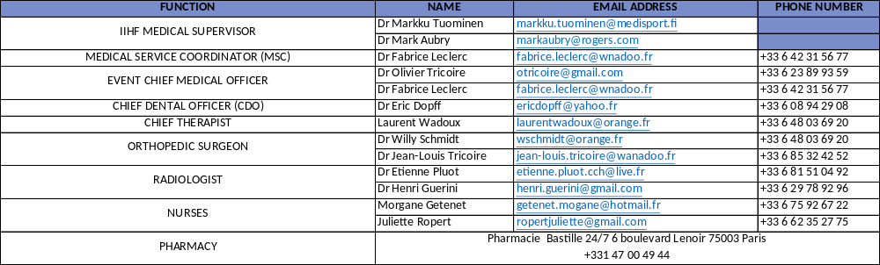
MEDICAL PERSONNEL PARIS CONTACT LIST

Slide 27
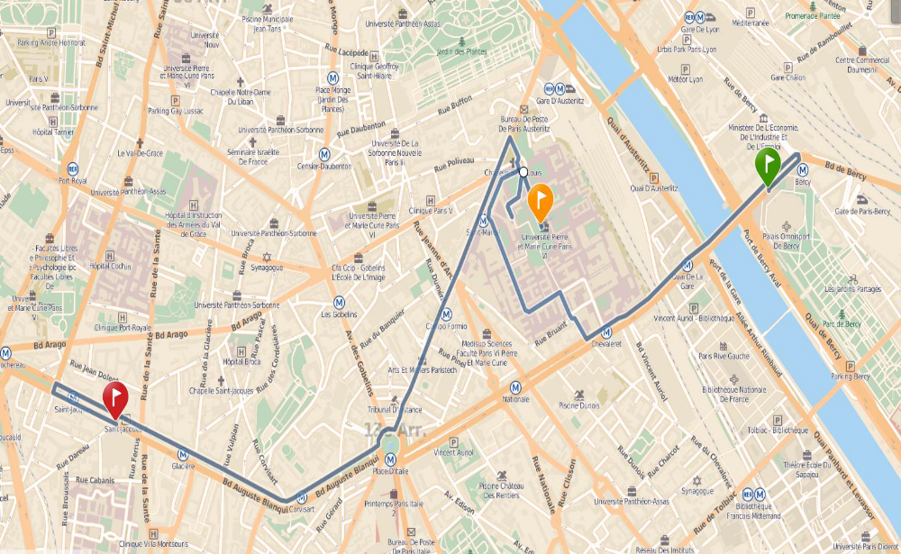
Hôpitaux universitaires La Pitié Salpêtrière (APHP)
47-83 Boulevard de l’Hôpital - 75013 Paris
01 42 16 00 00
MAIN REFERRING HOSPITAL

Slide 28
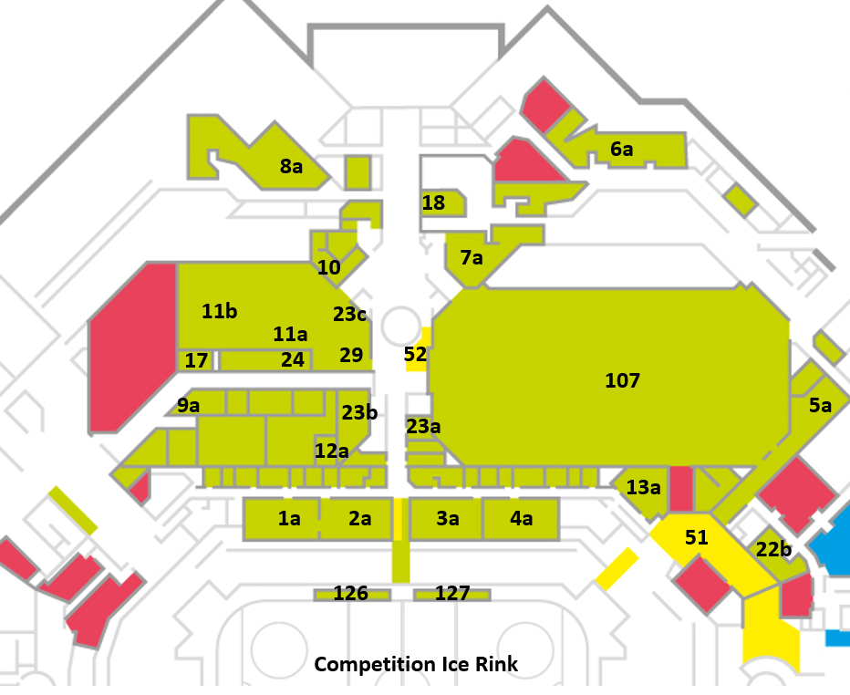
ARENA MAP
1a. CZE Dressing Room
2a. BLR Dressing Room
3a. NOR Dressing Room
4a. SUI Dressing Room
5a. FRA Dressing Room
6a. SLO Dressing Room
7a. CAN Dressing Room
8a. FIN Dressing Room
9a. Team Services Room
10. Team Laundry Room
11a. Team Stretching Area
11b. Team Warm-Up Area
12a. Team Uniform Service Centre Office
13a. Referees & Linesmen Dressing Room
17. Off Ice Officials Room
18. Team Skate Sharpening & Equipment Room
22b. Anti-Doping Control Room
23a. Medical Clinic
23b. Physio Room
23c. Zimmer Room
24. LOC Competition Office
29. Players’ Lounge
51. Mixed Zone Main Rink
52. Mixed Zone Practice Rink
107. Training Ice Rink
126. Team Bench 1
127. Team Bench 2

Slide 29
IIHF INJURY DEFINITION
An injury is considered resportable if a player misses a practice or a game because of an injury sustained during a practice or game.
The player doesn’t return to the play for the remainder of the game following the injury :
all concussions
any dental injury
any laceration which requires medical attention
all fractures

Slide 30


IIHF Daily Injury Report Form
IIHF Championship:
National Association:
Date: / / (dd/mm/yy)
Using this form, please report if there were any injuries sustained by any player on your
team during the above-mentioned day during this IIHF Championship. We would ask that you also report if there were no injuries sustained by players on your team during this day of this IIHF Championship. If an injury was sustained during this day then an IIHF Injury Report Form must be completed and submitted to the IIHF Medical Supervisor or, in his absence, to the IIHF Directorate Chairman providing the details of the injury sustained.
Please check (✓) the appropriate box below. Please provide the number of injuries
sustained if you check article ‘A’.
Injury Report (✓)
A. During this day there were injuries sustained by our team.
(number)
B. During this day there were no injuries sustained by our team
Team Physician/Medical Representative:
(print name)
Signature:
Date:
November 2010

Slide 31

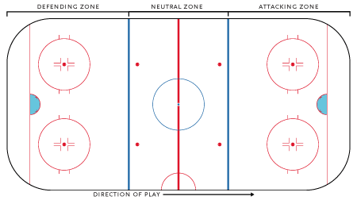
Injury Report System/IRS
(only one injury/form)
Injury Definition
The definition of an injury in the IIHF Injury Reporting System is as follows
1. An injury is considered reportable if a player misses a practice
or a game because of an injury sustained during a practice or a game
2. The player doesn't return to the play for the remainder of the game following an injury
3. All concussions
4. Any dental injury
5. Any laceration which requires medical attention
6. All fractures
Country: IIHF Championship: Date of injury: D M Y
Zone of Injury A
1. No contact with boards
2. Contact with boards
1 9
Zone of Injury B
Mark the area on the ice surface where the injury occured.
Note that Home and Visitor ends are marked to 2 3 4 5 6 7 8
identify offensive and defensive activity
1 ₉
Game / Period
Practice
1. warm up off-ice
on-ice
off-ice
on-ice
Home
Visitor
2. 1st 4. 3rd
3. 2nd 5. Ot
playing time:
Situation
Even Strength 5/5 Penalty Killing 4/5
3/3 3/4
Power Play 5/4 Goalie
4/3 2. No
4/4
3/5
5/3
1. Yes
Source of Diagnosis
1. Medical Doctor 2. Physiotherapist 3. Other
Player information:
1. Age
2. Height (cm)
3. Weight (kg)
Dx/assessment:
1. Contusion
2. Sprain (Ligament)
3. Strain (Muscle-Tendon)
4. Laceration
5. Dislocation/Subluxation
6. Fracture
7. Neurotrauma/Concussion
8. Other
Cause of injury:
1. Type of Check a. Body Check
c. Check to the Head
2. Stick Contact
3. Puck Contact
4. Unintended Collision
5. Fighting
6. Non-Contact
7. Skate
8. Other:
Side / Body part: fill out a separate form for each injury
1. N/A 2. Left 3. Right 4. Both
1. Head 10. Shoulder 19. Chest 28. Genitals
2. Face 11. Scapula 20. Abdomen 29. Hip
3. Neck 12. Upper arm 21. Kidneys 30. Thigh
4. Throat 13. Elbow 22. Upper Back 31. Knee
5. Jaw/Chin 14. Forearm 23. Lower Back 32. Leg
6. Teeth/Mouth 15. Wrist 24. Coccyx 33. Ankle
7. Eye 16. Hand 25. Buttocks 34. Foot
8. Ear 17. Thumb 26. Pelvis 35. Toes
9. Clavicle 18. Fingers 27. Groin 36. Other:
Dental: Mouthguard? 1. Yes 2. No
Custom made? 1. Yes 2. No
Knee: Circle the appropriate structure involved:
1. ACL 2. PCL 3. MCL 4. LCL 5. Meniscus 6. PF*
Grade: 1. 2. 3.
Shoulder: Circle the appropriate structure involved:
1. AC* 2. SC* 3. Glenohumeral
Grade: 1. 2. 3.
b. Check from Behind
Position:
1. Centre
2. Wing
3. Defence
4. Goalie
Time Lost:
The amount of time player is expected to be out of play
1. Return same day
2. Less than 1 week
3. 1 to 3 weeks
4. More than 3 weeks
Nature of injury:
1. Acute 2. Recurrent:
a. this season
b. last season
Was a penalty Called on the Play?
1. 2 min.
1. Yes 2. 2+2 min
2. No 3. 2+10 min
4. 5+20 min
5. Other:_
Diagnosis:
ICD-code
DG:
Equipment:
1. Full Face mask
b. cage
3. None
a. shield
PF= Patellofemoral, Kneecap AC= Acromioclavicular Joint
SC= Sternoclavicular Joint
2. Visor

Slide 32
THANK YOU !!

